Slide 1
NLP Sentiment Classification with Perceptron lecture 02.4
Branko Žitko

Slide 2
Contents
Vocabulary, Vectorizer
Dataset
DataLoader
A Perceptron Classifier
The Training Routine
Evaluation, Inference, Inspection

Slide 3
Vocabulary
Vocabulary maps token to index and vice versa
It can also use fixed index for unknown tokens.
ReviewVocab
RatingVocab
the →
token | idx
-1 | <unk>
0 | unfortunately
1 | the
2 | frustration
…
n
→ 1
token | idx
0 | 1
1 | 2
2 →
→ frustration

Slide 4
Vocabulary
Vocabulary
class Vocabulary(object): def __init__(self, token_to_idx=None, add_unk=True, unk_token="<UNK>"): if token_to_idx is None: token_to_idx = {} self._token_to_idx = token_to_idx self._idx_to_token = {idx: token for token, idx in self._token_to_idx.items()} self._add_unk = add_unk self._unk_token = unk_token self.unk_index = -1 if add_unk: self.unk_index = self.add_token(unk_token) def add_token(self, token): if token in self._token_to_idx: index = self._token_to_idx[token] else: index = len(self._token_to_idx) self._token_to_idx[token] = index self._idx_to_token[index] = token return index def add_many(self, tokens): return [self.add_token(token) for token in tokens]

Slide 5
Vocabulary
…
def lookup_token(self, token): if self.unk_index >= 0: return self._token_to_idx.get(token, self.unk_index) else: return self._token_to_idx[token] def lookup_index(self, index): if index not in self._idx_to_token: raise KeyError("the index (%d) is not in the Vocabulary" % index) return self._idx_to_token[index] def to_serializable(self): return {'token_to_idx': self._token_to_idx, 'add_unk': self._add_unk, 'unk_token': self._unk_token} @classmethod def from_serializable(cls, contents): return cls(**contents) def __str__(self): return f"<Vocabulary(size={len(self)})>" def __len__(self): return len(self._token_to_idx)

Slide 6
Vectorizer
Vectorizer uses vocabulary to create one-hot vector encoding of review
Vector size is size of the vocabulary.
ReviewVectorizer
did take out because →
ReviewVocab
→ 0 0 1 0 0 1 1 0 0 1 0 0
RatingVocab

Slide 7
Vectorizer
Vectorizer encapsulates the review Vocabulary, which maps words in the review to integers.
class ReviewVectorizer(object): def __init__(self, review_vocab, rating_vocab): self.review_vocab = review_vocab self.rating_vocab = rating_vocab @classmethod def from_serializable(cls, contents): review_vocab = Vocabulary.from_serializable(contents['review_vocab']) rating_vocab = Vocabulary.from_serializable(contents['rating_vocab']) return cls(review_vocab=review_vocab, rating_vocab=rating_vocab) def to_serializable(self): return {'review_vocab': self.review_vocab.to_serializable(), 'rating_vocab': self.rating_vocab.to_serializable()}

Slide 8
Vectorizer
The method from_dataframe() iterates over the rows of a Pandas DataFrame with two goals: to count the frequency of all tokens present in the dataset. to create a Vocabulary that only uses tokens that are as frequent as a provided keyword argument to the method, cutoff.
@classmethod def from_dataframe(cls, review_df, cutoff=25): review_vocab = Vocabulary(add_unk=True) rating_vocab = Vocabulary(add_unk=False) # Add ratings for rating in sorted(set(review_df.rating)): rating_vocab.add_token(rating) # Add top words if count > provided count word_counts = Counter() for review in review_df.review: for word in review.split(" "): if word not in string.punctuation: word_counts[word] += 1 for word, count in word_counts.items(): if count > cutoff: review_vocab.add_token(word) return cls(review_vocab, rating_vocab)

Slide 9
Vectorizer
The method vectorize() encapsulates the core functionality of the Vectorizer. It takes as an argument a string representing a review and returns a vectorized representation of the review the collapsed one-hot representation the binary vector has a length equal to the size of the Vocabulary. the binary vector has 1 in the locations that correspond to the words in the review. limitations: vector is sparse discards the order in which the words appeared in the review (bag of words)
def vectorize(self, review): one_hot = np.zeros(len(self.review_vocab), dtype=np.float32) for token in review.split(" "): one_hot[self.review_vocab.lookup_token(token)] = 1 return one_hot

Slide 10
Dataset
Dataset contains review data and vectorizer in order to yield source (review) and target (rating) vectors from selected split.
ReviewDataset
rating | review | split
1 | Unfortunately, | train
2 | Stellar! | train
…
0 →
ReviewVectorizer
→ (0 0 1 0 0 1 1 0 0 1 0 0, 0)
rating | review | split
1 | After spending | val
2 | Been going to ... | val
…
rating | review | split
1 | Did take out | test
2 | Lee Lee's | test
…

Slide 11
DataSet
PyTorch provides an abstraction for the dataset by providing a Dataset class. The ReviewDataset class presented assumes that the dataset has been minimally cleaned and split into three partitions
from torch.utils import Dataset class ReviewDataset(Dataset): def __init__(self, review_df, vectorizer): self.review_df = review_df self._vectorizer = vectorizer self.train_df = self.review_df[self.review_df.split=='train'] self.train_size = len(self.train_df) self.val_df = self.review_df[self.review_df.split=='val'] self.validation_size = len(self.val_df) self.test_df = self.review_df[self.review_df.split=='test'] self.test_size = len(self.test_df) self._lookup_dict = {'train': self.train_df, 'val': self.val_df, 'test': self.test_df} self.set_split('train') def set_split(self, split="train"): self._target_split = split self._target_df = self._lookup_dict[split]

Slide 12
DataSet
The Dataset class is an abstract iterator. Subclassing (or inheriting from) the Dataset class requires implementation of __getitem__() and __len__() methods.
def __len__(self): return len(self._target_df) def __getitem__(self, index): row = self._target_df.iloc[index] review_vector = self._vectorizer.vectorize(row.review) rating_index = self._vectorizer.rating_vocab.lookup_token(row.rating) return {'x_data': review_vector, 'y_target': rating_index} def get_num_batches(self, batch_size): return len(self) // batch_size @classmethod def load_dataset_and_make_vectorizer(cls, review_csv): review_df = pd.read_csv(review_csv) train_review_df = review_df[review_df.split=='train'] vectorizer = ReviewVectorizer.from_dataframe(train_review_df) return cls(review_df, vectorizer)

Slide 13
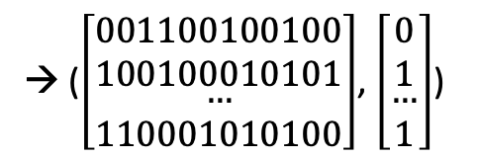
DataLoader
DataLoader wraps dataset as minibatch iterator.
ReviewDataset
rating | review | split
1 | Unfortunately, | train
2 | Stellar! | train
…
→ ($\left[\begin{matrix}001100100100 \\ 100100010101 \\ \begin{aligned}… \\ 110001010100\end{aligned}\end{matrix}\right]$, $\left[\begin{matrix}0 \\ 1 \\ \begin{aligned}… \\ 1\end{aligned}\end{matrix}\right]$)
ReviewVectorizer
rating | review | split
1 | After spending | val
2 | Been going to ... | val
…
rating | review | split
1 | Did take out | test
2 | Lee Lee's | test
…

Slide 14
DataLoader
DataLoader is used for grouping the vectorized datapoints. It coordinates the process of grouping into minibatches.
from torch.utils import DataLoader def generate_batches(dataset, batch_size, shuffle=True, drop_last=True, device="cpu"): dataloader = DataLoader(dataset=dataset, batch_size=batch_size, shuffle=shuffle, drop_last=drop_last) for data_dict in dataloader: out_data_dict = {} for name, tensor in data_dict.items(): out_data_dict[name] = data_dict[name].to(device) yield out_data_dict

Slide 15
A Percepton Classifier
ReviewClassifier inherits from PyTorch’s Module and creates a single Linear layer with a single output. Because this is a binary classification setting (negative or positive review), this is an appropriate setup. The sigmoid function is used as the final nonlinearity.
import torch import torch.nn as nn import torch.nn.functional as F class ReviewClassifier(nn.Module): def __init__(self, num_features): super(ReviewClassifier, self).__init__() self.fc1 = nn.Linear(in_features=num_features, out_features=1) def forward(self, x_in, apply_sigmoid=False): y_out = self.fc1(x_in).squeeze() if apply_sigmoid: y_out = torch.sigmoid(y_out) return y_out

Slide 16
The Training Routine
We use the Namespace class from the built-in argparse package because it nicely encapsulates a property dictionary and works well with static analyzers.
args = Namespace( # Data and Path information frequency_cutoff=25, model_state_file='model.pth', review_csv='reviews_with_splits_lite.csv', # review_csv='data/yelp/reviews_with_splits_full.csv', save_dir='.', vectorizer_file='vectorizer.json', # No Model hyper parameters # Training hyper parameters batch_size=128, learning_rate=0.001, num_epochs=100, seed=1337, # Runtime options catch_keyboard_interrupt=True, cuda=True, expand_filepaths_to_save_dir=True, reload_from_files=False, )

Slide 17
The Training Routine
The training routine is responsible for: instantiating the model, iterating over the dataset, computing the output of the model when given the data as input, computing the loss (how wrong the model is), and updating the model proportional to the loss.
dataset = ReviewDataset.load_dataset_and_make_vectorizer(args.review_csv) vectorizer = dataset.get_vectorizer() classifier = ReviewClassifier(num_features=len(vectorizer.review_vocab)) args.device = torch.device("cuda" if args.cuda else "cpu") classifier = classifier.to(args.device) loss_func = nn.BCEWithLogitsLoss() optimizer = optim.Adam(classifier.parameters(), lr=args.learning_rate) scheduler = optim.lr_scheduler.ReduceLROnPlateau(optimizer=optimizer, mode='min', factor=0.5, patience=1) def compute_accuracy(y_pred, y_target): y_target = y_target.cpu() y_pred_indices = (torch.sigmoid(y_pred) > 0.5).cpu().long() n_correct = torch.eq(y_pred_indices, y_target).sum().item() return n_correct / len(y_pred_indices) * 100

Slide 18
The Training Routine
Train Split zero the gradients compute the output compute the loss (moving average) use loss to produce gradients use optimizer to take gradient step compute the accuracy
for epoch_index in range(args.num_epochs): # TRAIN dataset.set_split('train') batch_generator = generate_batches(dataset, batch_size=args.batch_size, device=args.device) running_loss = 0 running_acc = 0 classifier.train() for batch_index, batch_dict in enumerate(batch_generator): optimizer.zero_grad() # step (1) y_pred = classifier(x_in=batch_dict['x_data'].float()) # step (2) # step (3) loss = loss_func(y_pred, batch_dict['y_target'].float()) loss_t = loss.item() running_loss += (loss_t - running_loss) / (batch_index + 1) loss.backward() # step (4) optimizer.step() # step (5) # (6) acc_t = compute_accuracy(y_pred, batch_dict['y_target']) running_acc += (acc_t - running_acc) / (batch_index + 1) print(f"Train epoch: {epoch_index}/{args.num_epochs} loss: {running_loss} acc: {running_acc}")

Slide 19
The Training Routine
Val Split compute the output compute the loss (moving average) compute the accuracy update the learning rate of the optimizer according to the loss after validation
# VAL dataset.set_split('val') batch_generator = generate_batches(dataset, batch_size=args.batch_size, device=args.device) running_loss = 0 running_acc = 0 classifier.eval() for batch_index, batch_dict in enumerate(batch_generator): y_pred = classifier(x_in=batch_dict['x_data'].float()) # (1) # (2) loss = loss_func(y_pred, batch_dict['y_target'].float()) loss_t = loss.item() running_loss += (loss_t - running_loss) / (batch_index + 1) # (3) acc_t = compute_accuracy(y_pred, batch_dict['y_target']) running_acc += (acc_t - running_acc) / (batch_index + 1) scheduler.step(running_loss) # (4) print(f"Valid epoch: {epoch_index}/{args.num_epochs} loss: {running_loss} acc: {running_acc}")

Slide 20
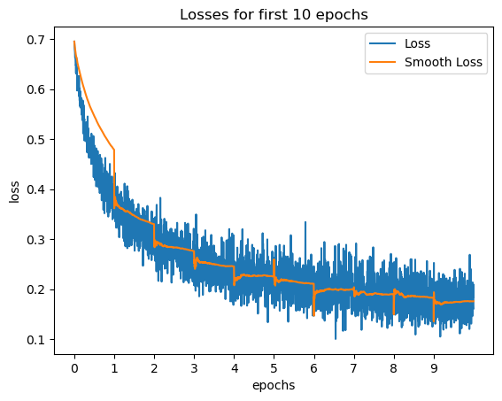
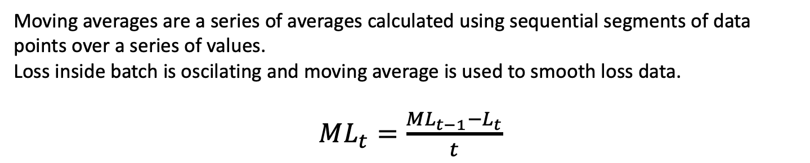
The Training Routine
Moving averages are a series of averages calculated using sequential segments of data points over a series of values.
Loss inside batch is oscilating and moving average is used to smooth loss data.
$ML_{t}=\frac{ML_{t−1}−L_{t}}{t}$

Slide 21
Evaluation
Test Split compute the output compute the loss (moving average) compute the accuracy
classifier = classifier.to(args.device) dataset.set_split('test') batch_generator = generate_batches(dataset, batch_size=args.batch_size, device=args.device) running_loss = 0 running_acc = 0 classifier.eval() for batch_index, batch_dict in enumerate(batch_generator): y_pred = classifier(x_in=batch_dict['x_data'].float()) # (1) # (2) loss = loss_func(y_pred, batch_dict['y_target'].float()) loss_t = loss.item() running_loss += (loss_t - running_loss) / (batch_index + 1) # (3) acc_t = compute_accuracy(y_pred, batch_dict['y_target']) running_acc += (acc_t - running_acc) / (batch_index + 1) print(f"Test loss: {running_loss} acc: {running_acc}")

Slide 22
Inference
Another method for evaluating the model is to do inference on new data and make qualitative judgments about whether the model is working.
def predict_rating(review, classifier, vectorizer, decision_threshold=0.5): review = preprocess_text(review) vectorized_review = torch.tensor(vectorizer.vectorize(review)) result = classifier(vectorized_review.view(1, -1)) probability_value = F.sigmoid(result).item() index = 1 if probability_value < decision_threshold: index = 0 return vectorizer.rating_vocab.lookup_index(index) test_review = "this is a pretty awesome notebook" prediction = predict_rating(test_review, classifier, vectorizer) print(f"{test_review} -> {prediction}")
this is a pretty awesome book -> positive

Slide 23
Inspection
Inspecting the model's weights and make qualitative judgments about whether they seem correct. With the perceptron and a collapsed one-hot encoding this is fairly straightforward because each model weight corresponds exactly to a word in our vocabulary.
fc1_weights = classifier.fc1.weight.cpu().detach()[0] weights, indices = torch.sort(fc1_weights, dim=0, descending=True) indices = indices.numpy().tolist() print("Influential words in Positive Reviews:") print("--------------------------------------") for i in range(20): print(vectorizer.review_vocab.lookup_index(indices[i]))
Influential words in Positive Reviews: -------------------------------------- delicious pleasantly fantastic amazing ...
print("Influential words in Negative Reviews:") print("--------------------------------------") indices.reverse() for i in range(20): print(vectorizer.review_vocab.lookup_index(indices[i]))
Influential words in Negative Reviews: -------------------------------------- worst mediocre bland horrible ...

